Slide 1
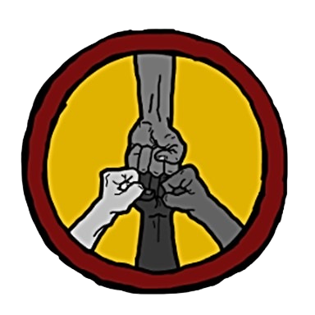
NORTHFIELD ANTIRACIST ACTION COALITION
NAAC
NAAC was created in the summer of 2020
as a joint effort of a diverse group of organizations
and community members in Northfield.
The work will be ongoing as long as it is needed.
{
Rice County Neighbors United / Vecinxs Unidxs
NorthSTAR
FOUNDING
MEMBERS
Both founding organizations invited others to join NAAC:
Stand Up Northfield
Women’s March
Say Their Names
Members of the Northfield Human Rights Commission
And many community members

Slide 2
NORTHFIELD ANTIRACIST ACTION COALITION
NAAC
Vision and Mission Statement
We know racism and discrimination exists in Northfield in all areas and we want to commit towards changes and actions out of love and care for our community.
Because Black, Indigenous and People of Color (BIPOC) are most impacted by both the current conditions and potential solutions, BIPOC voices are prioritized in all our work.
We are an open group of neighbors, non-hierarchical, community-focused group that recognizes everyone’s leadership and expertise. Our door is always open to foster dialogue and find solutions.

Slide 3
NORTHFIELD ANTIRACIST ACTION COALITION
NAAC
Northfield Data: Population 20,347 (2019)
Racial makeup (From the City of Northfield website)
As of the 2010 census, the racial makeup of the city was:
88.8% white,
3.5% Asian,
1.3% African American,
0.2% Native American,
4.0% from other races,
and 2.2% from two or more races.
Hispanics or Latinx of any race accounted for 8.4% of the population.

Slide 4
NORTHFIELD ANTIRACIST ACTION COALITION
NAAC
First Year and Phase 1: 2020-2021
Structure of the work:
Large meetings open to the community every two months
Work groups by area meet more often at their own pace
Groups by area:
Housing
Education at the public schools
Religious institutions,
Local government and city services
Community life
Hispanic/Latinx community
Workplaces, businesses and employment

Slide 5
NORTHFIELD ANTIRACIST ACTION COALITION
NAAC
Second Year and Phase 2: 2021-2022
Initiative chosen on Monday, October 4, 2021:
Pathways to Homeownership
Collecting Stories and Mapping Northfield:
Rice County Neighbors United has been working since 2020 on creating interactive maps to show disparities and segregation in Northfield.
NorthSTAR started collecting stories of discrimination and racism in our community during the summer of 2020.
Combining efforts:
Both projects merged during the summer of 2021.
The goal: To have a website with the maps and stories

Slide 6
NORTHFIELD ANTIRACIST ACTION COALITION

Slide 7
NORTHFIELD ANTIRACIST ACTION COALITION
NAAC
The Coalition’s work has been mostly entirely based on the volunteer work of all members and we are working to keep finding funds for this important work.
Thank you for your interest in NAAC!
FACEBOOK:
https://www.facebook.com/Northfield-Antiracist-Action-Coalition-NAAC-104441725312093
Contact for Rice County Neighbors United: www.neighborsunitedofnorthfield.org
Mar Valdecantos: marvaldecantos@yahoo.com

