Slide 1
NorthSTAR
Northfield Strives Toward Anti-Racism

Slide 2
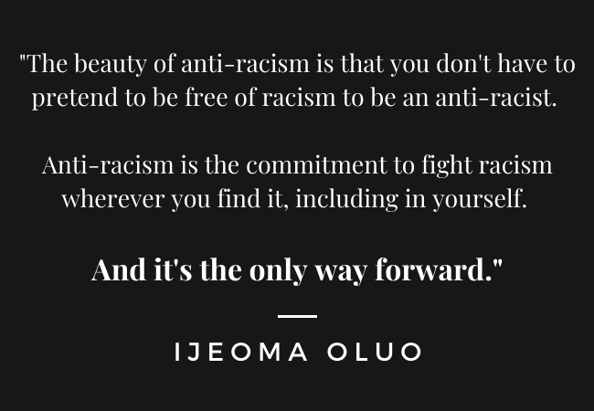

Slide 3
Who are we?
We are a core group of alumni from the classes of 2011-2018
Our mission is to create a school environment that is supportive, inclusive, and values the experiences of all students and staff. We urge school members to recognize how white supremacy has created and continues to influence our current structures, and hold them accountable to changing these structures.
We are looking for additional members! If you know of anybody with an interest in antiracist work within Northfield Schools, please send them our way. We are especially interested in connecting with people who currently live in Northfield and have lived experience as BIPOC in the Northfield schools.

Slide 4
What do we do?
We meet with elements of the Northfield Public Schools to raise awareness and plan actions around antiracist initiatives.
Superintendent of schools and district administration
School Board
Black Student Union
Latina mothers (through NAAC)
We collect stories from students, alumni, and community members about their experiences with racism in the schools. Listen to our story collection on Youtube.
We engage with the community to grow an antiracist movement in Northfield.
Notes:
You’ll see in the next slides that the district has made awesome progress in its antiracist initiatives around symbolism - changing names of schools and mascot. We are pushing the district to enact changes that impact the everyday student experience as well.

Slide 5
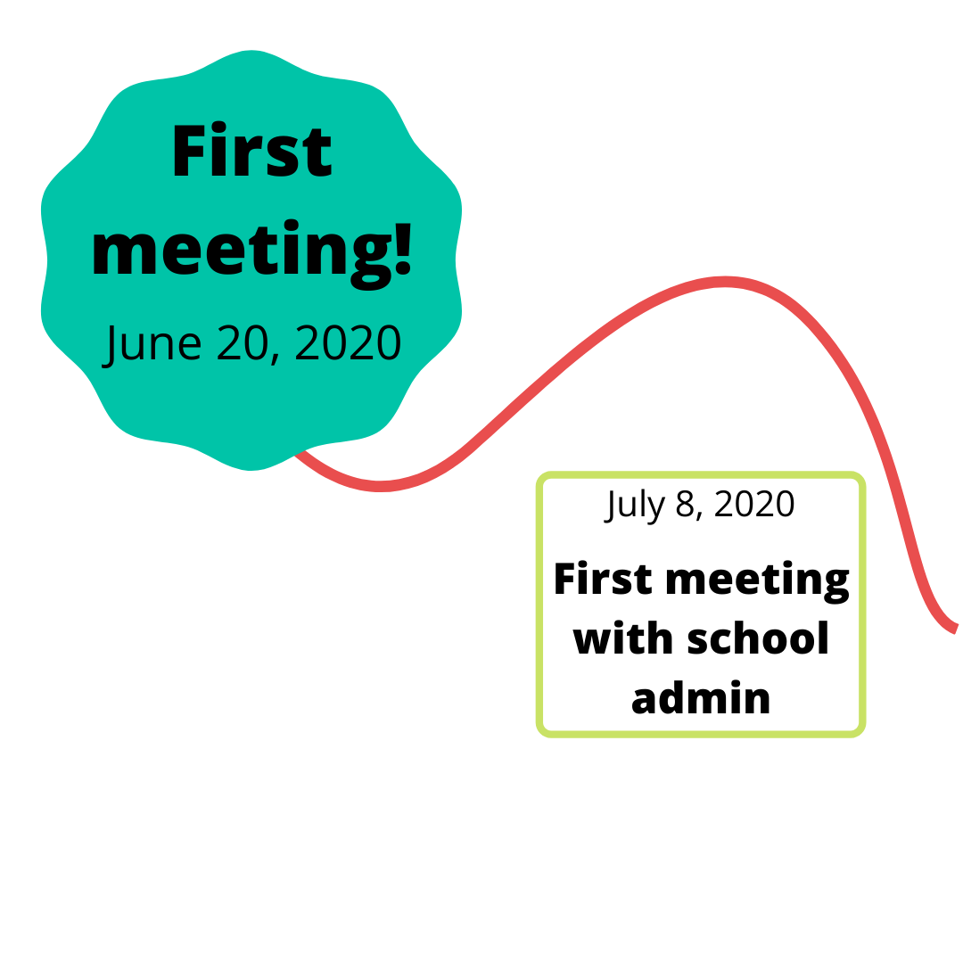
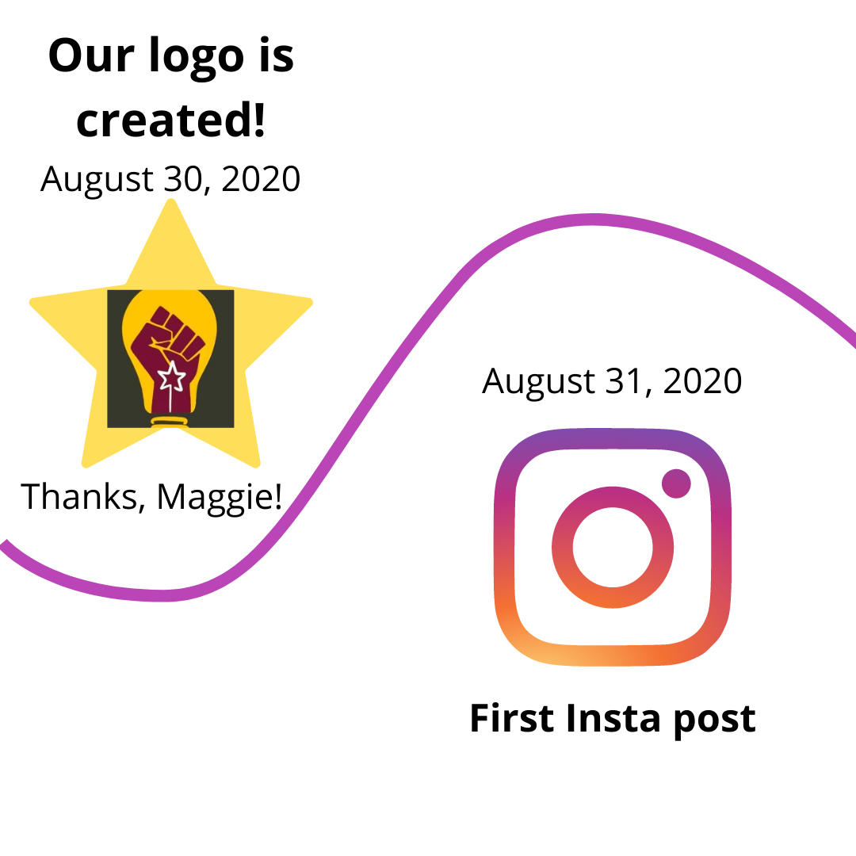

Slide 6
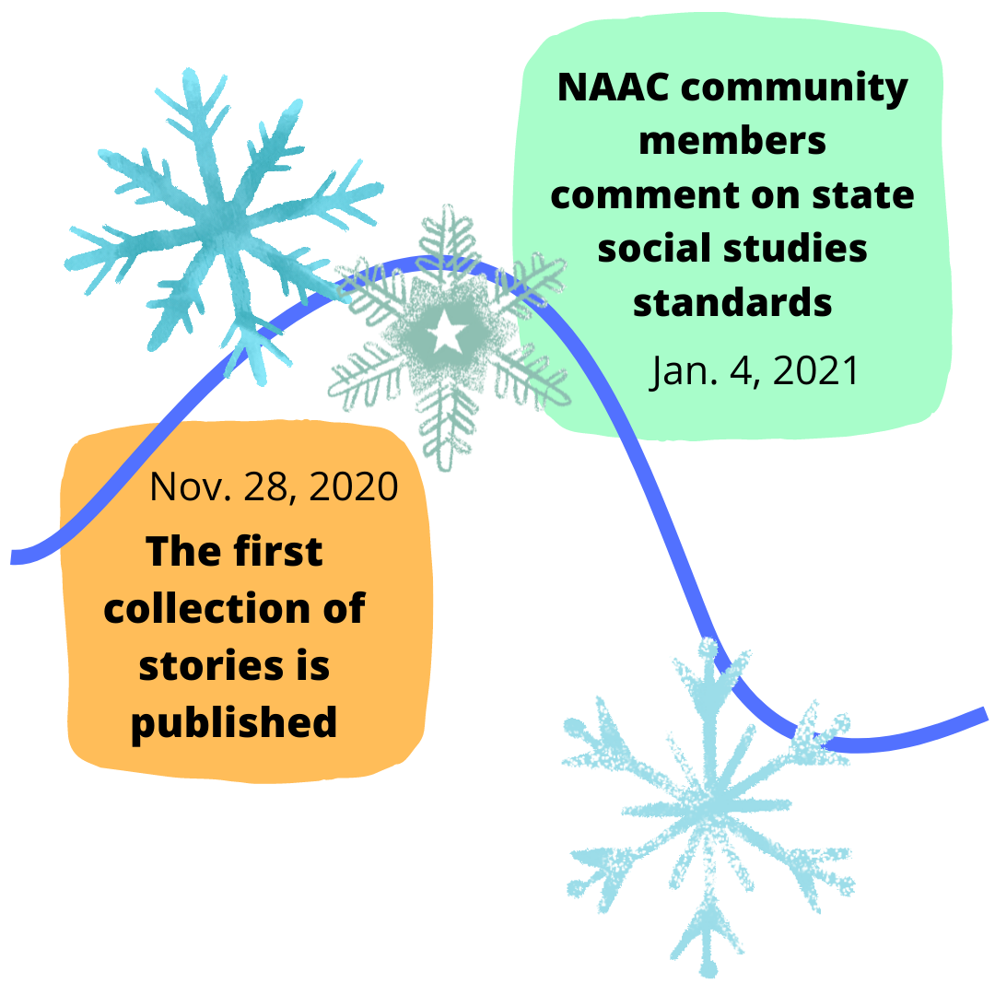

Slide 7
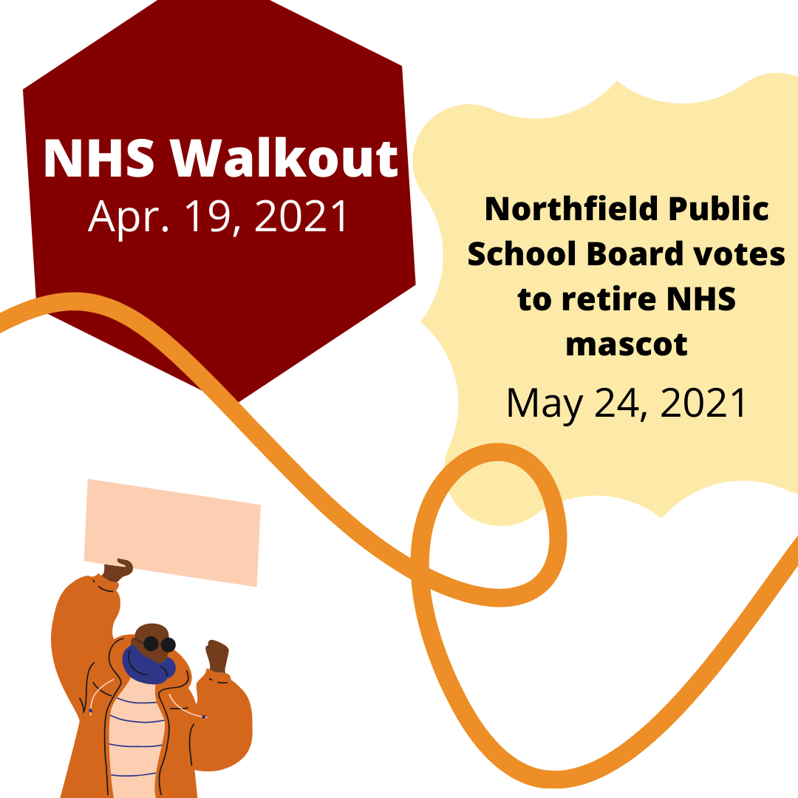
Timeline!

Slide 9
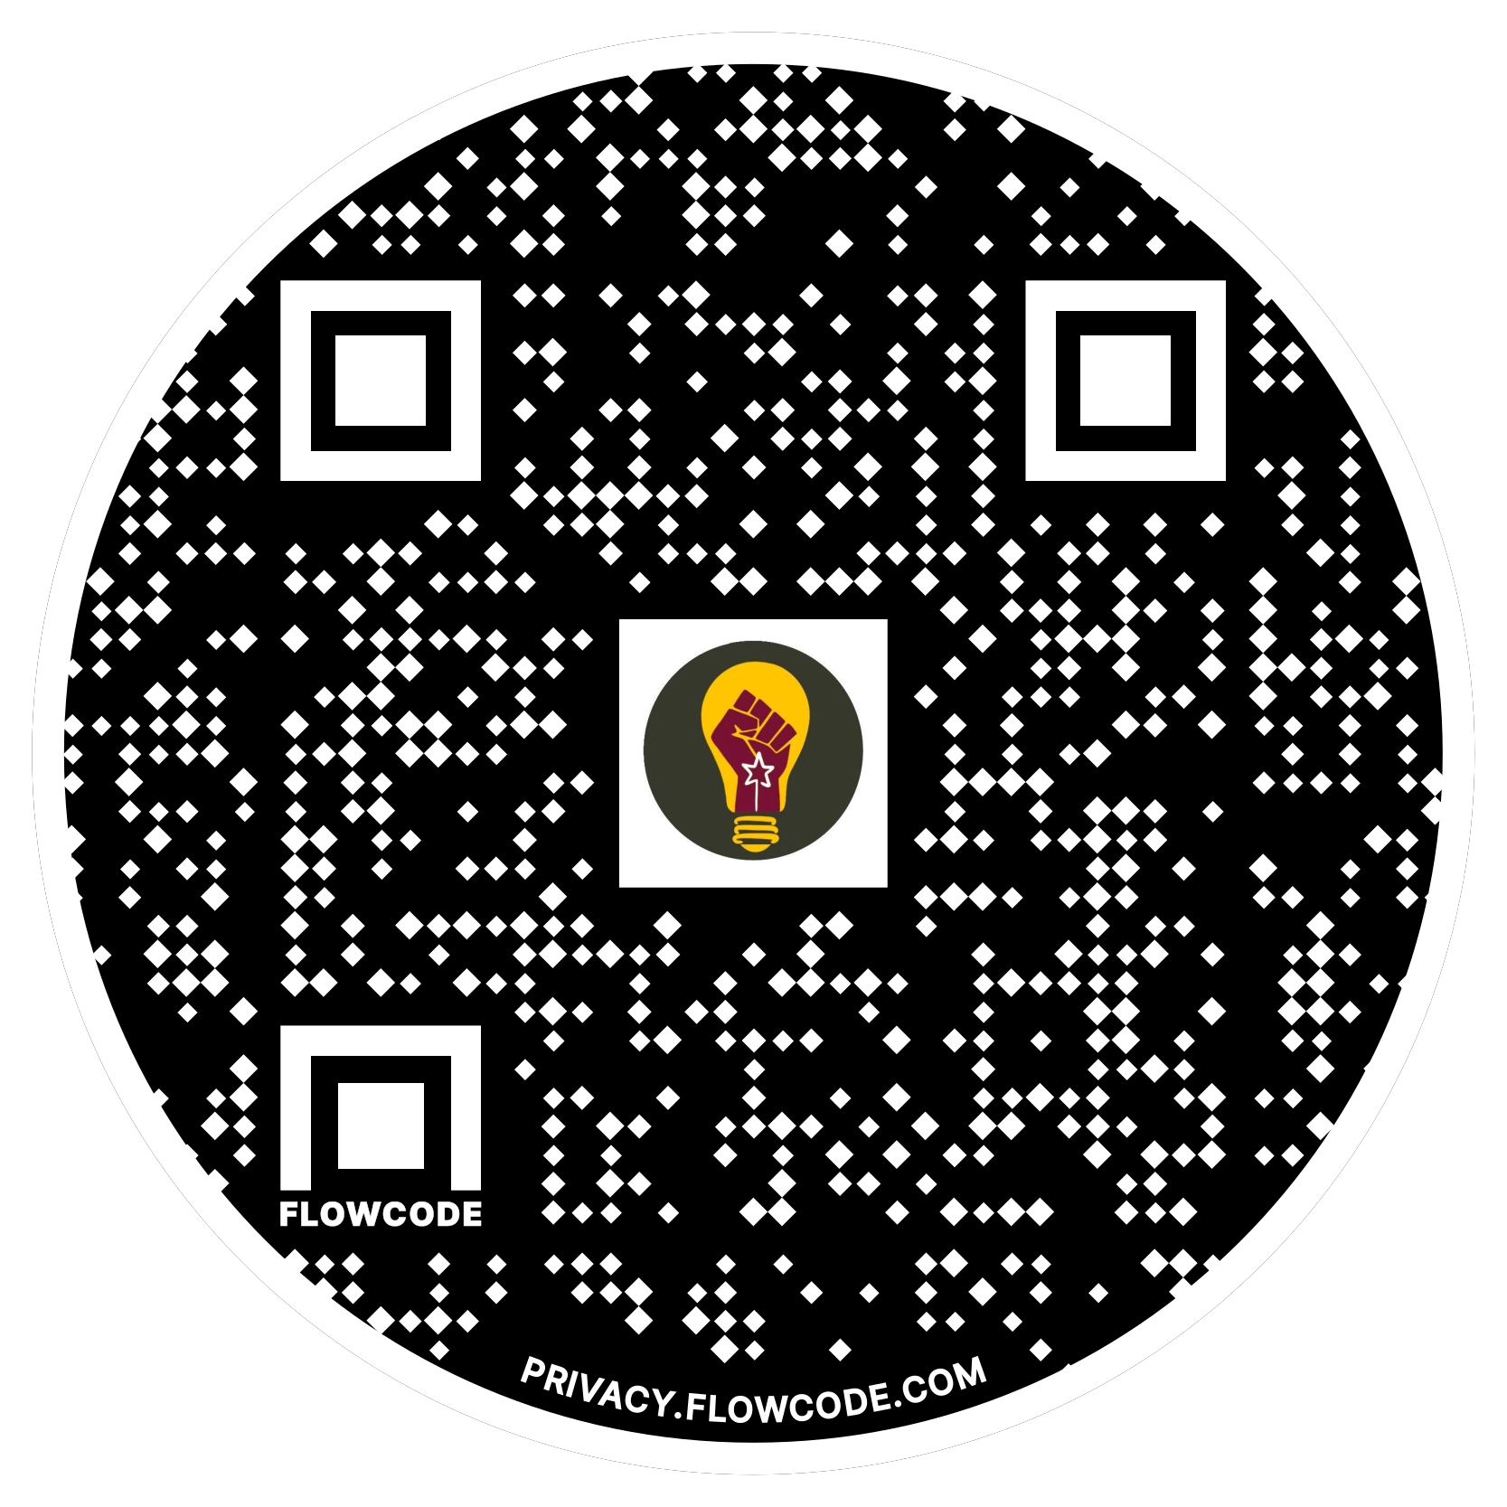
Thank you!
Contact information: Liz Coffield elizabeth.coffield@gmail.com
Youtube
Instagram

