Slide 1
From Trauma to Triumph: Cultivating Hope and Resilience
Dr. Kelly Sherman-Conroy

Slide 2
Handprints Of Our Heart
By Steven Charleston
We are all called each in our own way
To do the work of creation
Knitting together the many strands of grace
That hold the universe together.
We each have a task to perform
Even if we are not always aware
Of its true purpose or intent.
We may not even know what good we have done
Until the great cycles of love turn round
And we discover the blessing we have been.
When the curtain parts, we suddenly feel
The cool air of heaven billowing about us
And for only an instant
We know that we have made a difference
We are called, called to be what no other can be
The handprint of our heart on the long walls of time.

Slide 3
MY STORY

Slide 4
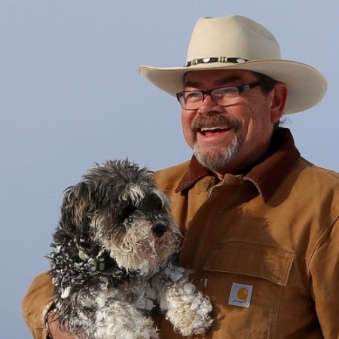
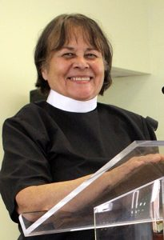
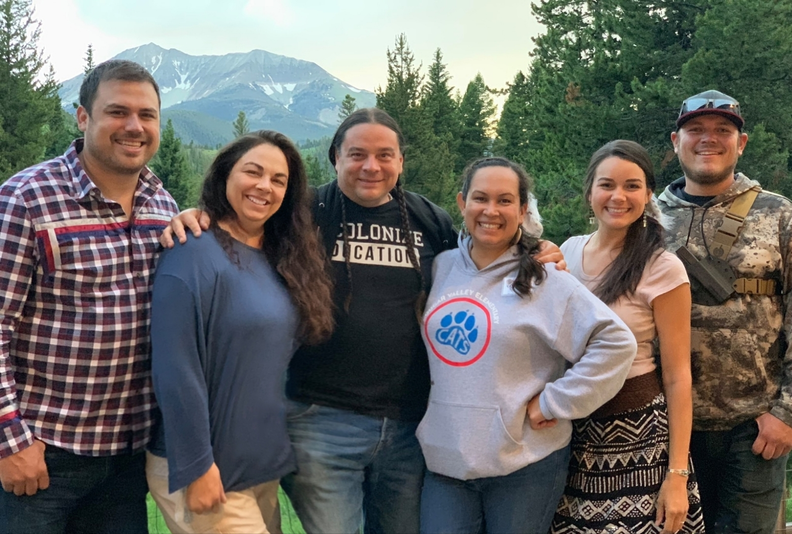
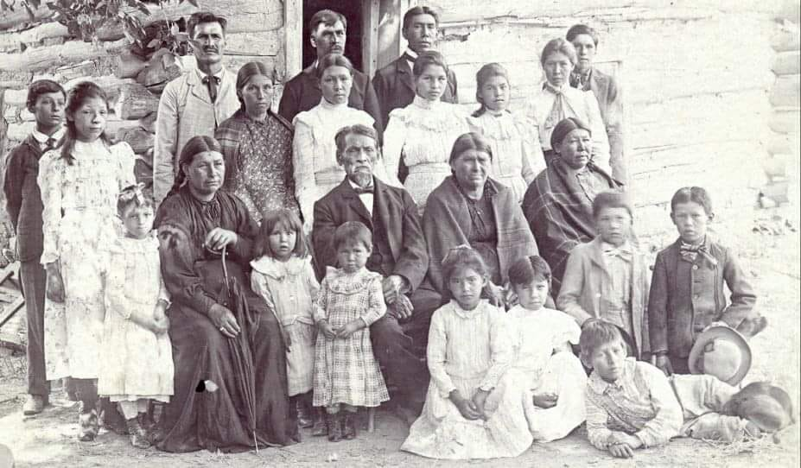
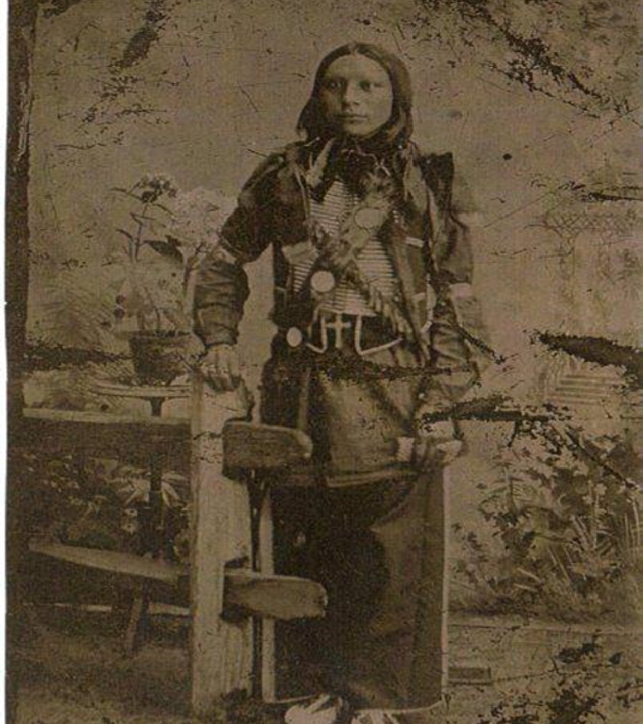
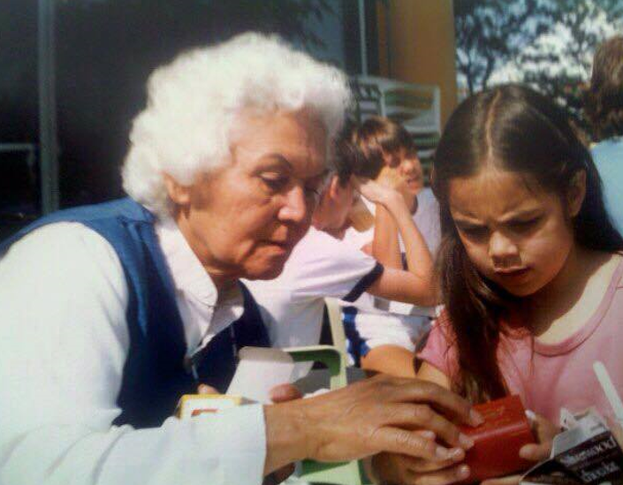
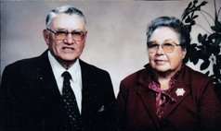

Slide 5
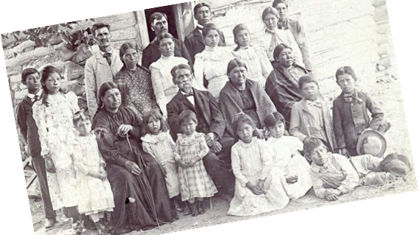

Slide 6
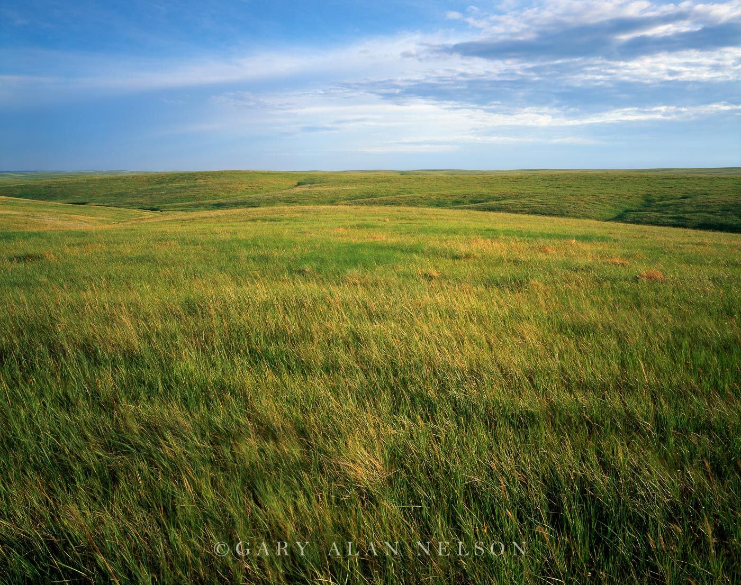

Slide 7
Lakol Wicho’an kin, carries a belief that when words are spoken, that speaker’s soul and spirit are attached to those words. When a Lakota elder speaks, their words are taken very seriously as the person(s) are listening carefully.
Black Elk as a Catholic teacher and as a Lakota leader. (Left photo: Marquette University Archives, Bureau of Catholic Indian Mission Records, ID 00559
Notes:
over a period of time as they participate within community and practice listening to what is said to them. Lakota children are surrounded by constant oral tradition at home, gatherings and ceremonies that help teach and guide them in traditional ways of the Lakota. Oral tradition brings the wakan into daily context

Slide 8
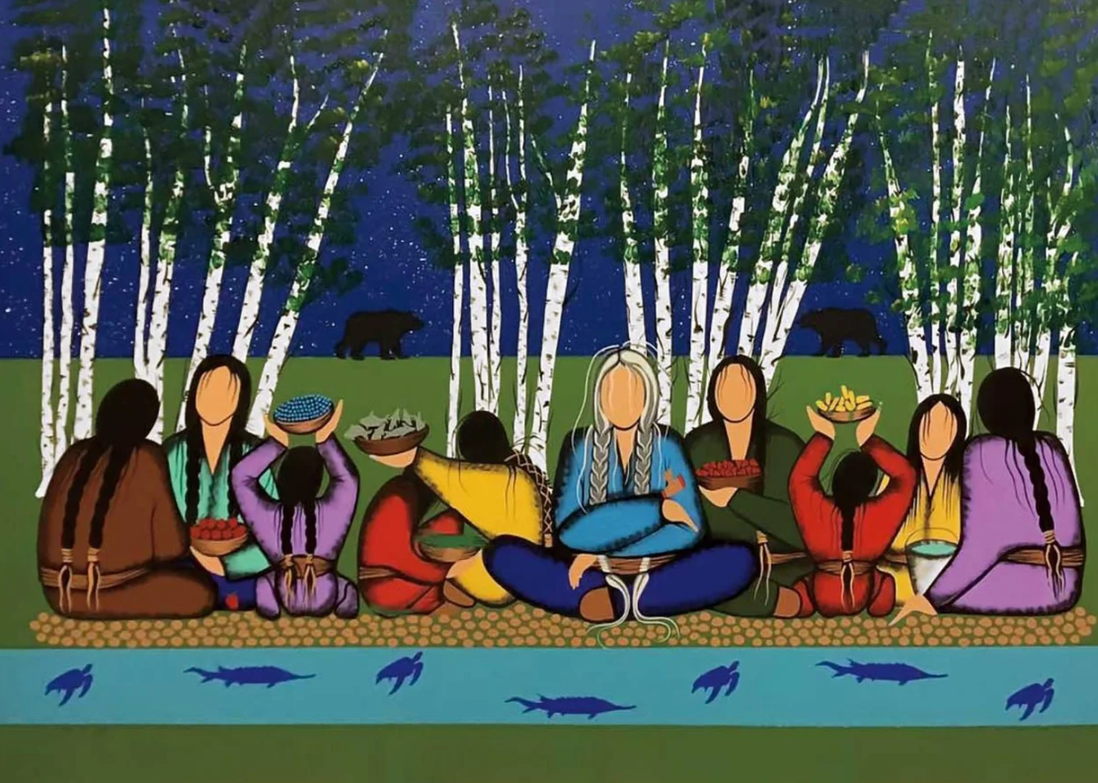
GENERATIONAL TRAUMA
Acknowledgement
Collective Journey
It's about seeing the invisible threads that connect the trauma of ancestors to the challenges faced by their descendants today.
Notes:
The concept of trauma extends beyond personal experiences of grief or distress. It encompasses the profound impact on individuals and communities, often transmitted across generations.
Generational Trauma—a form of injury inflicted upon the body and soul, not by a single event but by an ongoing legacy of oppression. It's a trauma that lives in our societies, in our institutions, and even within our bodies. It's a reminder that the fight against trauma is also a fight against the systemic injustices that perpetuate it.
But how do we begin to address such a pervasive issue? The first step is acknowledgment. We must acknowledge the historical and intergenerational trauma that exists within our communities. This acknowledgment isn't merely about recognizing the past; it's about understanding how the past continues to shape the present. It's about seeing the invisible threads that connect the trauma of ancestors to the challenges faced by their descendants today.
Drawing from the wisdom of Lakota traditions, we learn that healing from trauma is not a journey that one embarks on alone. It is a communal process, deeply rooted in the understanding that we are all connected—to each other, to our past, and to the land that sustains us. Indigenous healing practices teach us the importance of rituals, storytelling, and a deep connection to nature as pathways to recovery.

Slide 9
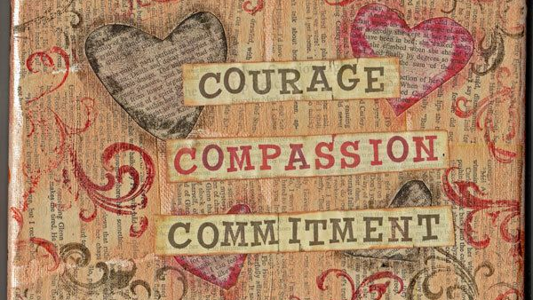
Notes:
healing is possible. It requires courage, compassion, and a commitment to confronting the uncomfortable truths of our shared history. Let us embrace the wisdom of those who have walked this path before us, and let us walk together towards a future where trauma no longer defines our communities.

Slide 10
Notes:
But most importantly it is about understanding our connectededness.

Slide 11
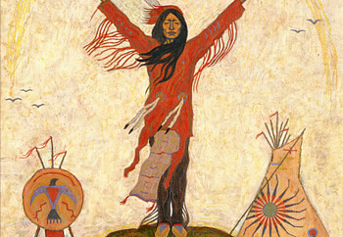
Notes:
explore a deeply profound and sacred practice—a practice that bridges the wisdom of Native traditions with our Christian faith, guiding us towards a more intimate experience of God's presence within us. This practice is known as breath prayer, a simple yet powerful way to feel God in our bodies, reminding us of the Creator's life-giving spirit that flows through all creation.
In many Native traditions, breath is considered the essence of life, a sacred gift from the Creator that connects us to every living thing. It is believed that with each breath, we share in the breath of the Creator, a divine cycle that unites heaven and earth, spirit and body. This understanding invites us to see our breath not merely as a physical necessity but as a spiritual link to the Divine, a constant reminder of God's closeness and immanence.
The beauty of breath prayer lies in its simplicity and its power to draw us into a deeper awareness of God's presence within us and around us.
As we engage in breath prayer, we are invited to slow down, to become mindful of the moment, and to listen to the gentle whisper of God speaking in the silence of our hearts. It is a practice that transcends words, reaching beyond the confines of language to touch the soul in its deepest longing for connection with the God.

Slide 12
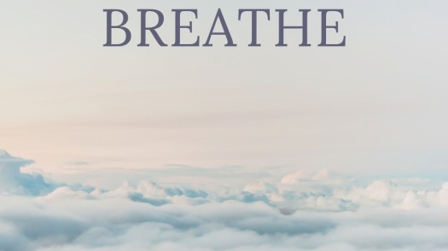
Notes:
Breath prayer also offers us a tangible way to feel God in our bodies. As we breathe in, we imagine drawing in the Holy Spirit, filling us with God's peace and love. As we breathe out, we release our fears, anxieties, and anything that separates us from God. This rhythmic cycle becomes a sacred dance of receiving and surrendering, a physical manifestation of our spiritual relationship with the Creator.
Native traditions teach us to honor and respect our bodies as temples of the Holy Spirit, as sacred vessels that carry the breath of life. By engaging in breath prayer, we affirm this truth, recognizing our bodies as integral to our spiritual journey, as places where heaven and earth meet, where the divine and human embrace.

Slide 13
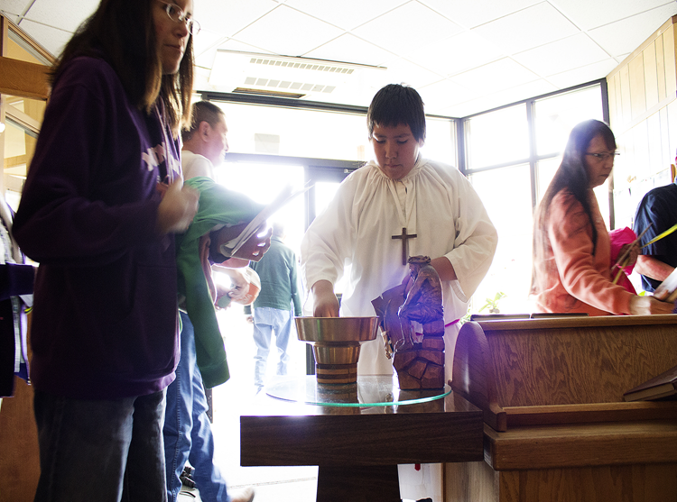
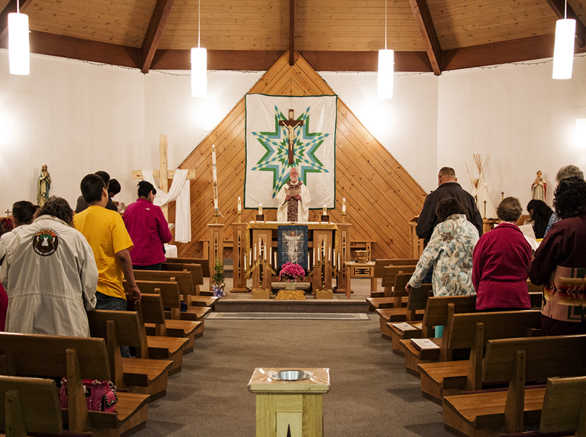
Notes:
In light of the spiritual and cultural trauma there is hope and healing amongst Native Christians.
Holy Spirit surrounds me and my people and connects us with a source of power which allows our people to survive so much racism and trauma of the past and present. We do not pity ourselves. We celebrate each other’s victories and mourn each other’s losses. We see the beauty of who we are and where we are from. God gives us visions of a good life. God has given us inspiration and hope through our visions. We are strong and resilient.

Slide 14
Have you considered the idea that being fully human is the essence of spirituality?
Go out and tend Mother Earth in some way today.Feel the sense of spirituality it gives you.

